Slide 1
SPOTIFY MUSIC RECOMMENDATION SYSTEM
TSP- AI ML Fundamentals (Capstone Project)
Presented By:
MUGESH KUMAR S – au810021114049
Guided By: Ramar Bose Sr. AI Master Trainer

Slide 2
OUTLINE
Problem Statement
Proposed System/Solution
Algorithm & Deployment
GitHub Link
Project Demo(photos / videos)
Conclusion
Future Scope
References

Slide 3
Problem Statement
Despite Spotify's vast music library and personalized playlist features, users still encounter challenges in discovering new music that aligns with their preferences and mood. The existing recommendation system may not sufficiently capture the nuances of individual tastes or adapt to evolving listening habits, leading to suboptimal user satisfaction and engagement. Additionally, the sheer volume of available songs presents a daunting task for users to navigate, resulting in decision fatigue and potential disengagement from the platform. To address these issues, there is a need for an advanced music recommendation system for Spotify that utilizes cutting-edge algorithms and user-centric approaches to deliver highly personalized and relevant song suggestions, thereby enhancing the overall music discovery experience and fostering long-term user loyalty.

Slide 4
Proposed Solution
The Spotify Music Recommendation System involves the implementation of a multi-faceted approach that combines machine learning algorithms, user interaction data analysis, and content-based filtering techniques. This system will leverage collaborative filtering to identify music preferences based on user behavior and preferences, utilizing implicit and explicit feedback to refine recommendations. Additionally, content-based filtering will be employed to analyze song attributes such as genre, tempo, and mood, enabling the system to suggest tracks that align with the user's current listening context.

Slide 5
Algorithm & Deployment
Algorithm:
Data Collection: Gather user interaction data and track metadata.
Preprocessing: Clean and format data, engineer features.
Model Development: Use collaborative filtering, content-based filtering, or hybrid models.
Training and Evaluation: Split data, train models, evaluate performance.
Deployment:
Infrastructure Setup: Deploy on cloud services.
API Development: Create an API for user interaction.
Integration with Spotify: Connect the system with Spotify.
Monitoring and Maintenance: Continuously monitor and update the system.

Slide 6
GitHub Link
https://github.com/kumar1415/Naan-mudhalvan-project-au810021114049

Slide 7
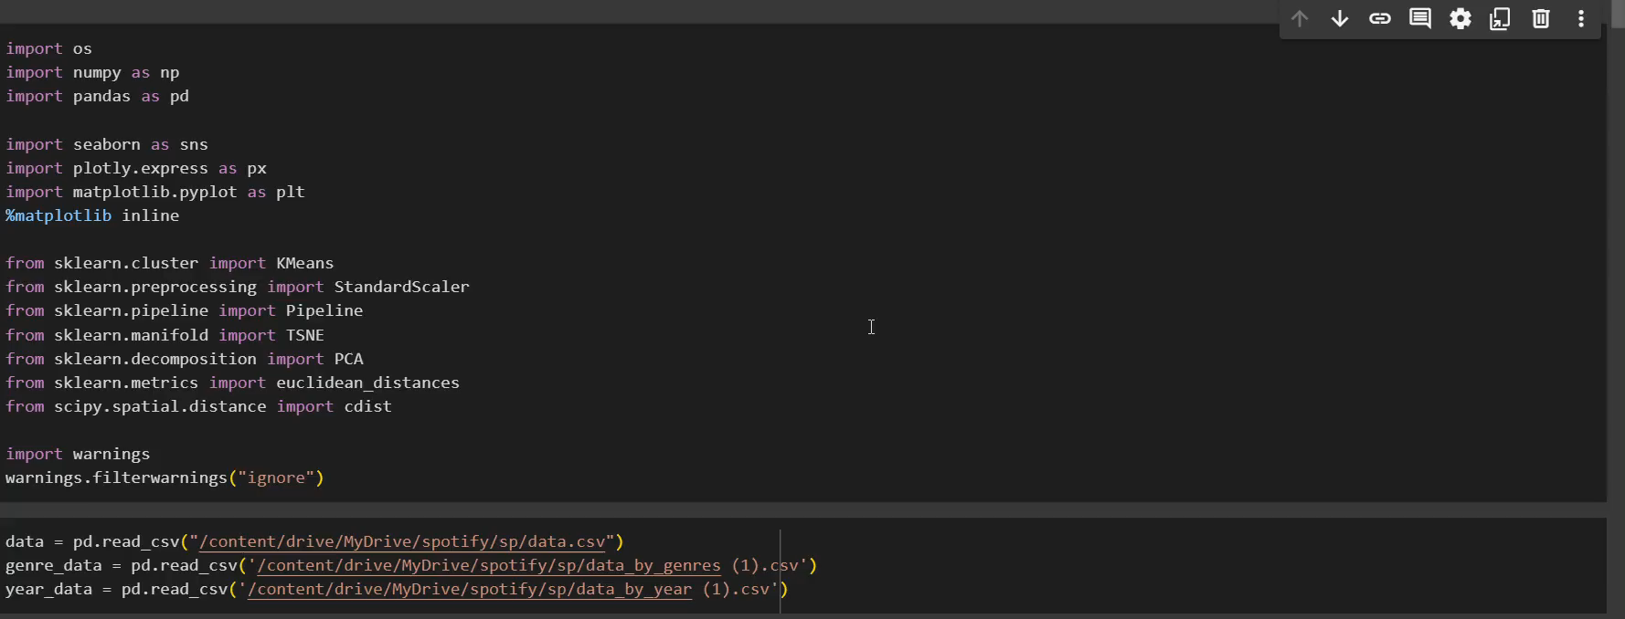
Project Demo(Recorded Video)

Slide 8
Conclusion
Building a Spotify Music Recommendation System involves collecting and preprocessing data, developing recommendation algorithms, training models, and deploying the system. Once deployed, it integrates with Spotify, providing personalized recommendations to users based on their preferences and behavior. Continuous monitoring and updates ensure its effectiveness over time, ultimately enhancing user experience and engagement with the platform.

Slide 9
Future Scope
Spotify's music recommendation system lies in further enhancing personalization through advanced machine learning techniques, incorporating multimodal data such as user context and mood, and leveraging emerging technologies like AI-driven conversational interfaces for more intuitive interactions. Additionally, integrating social listening features and incorporating user-generated content could enrich the recommendation process, fostering a more engaging and community-driven music discovery experience.

Slide 10
References
Project Github link, Ramar Bose , 2024
Project video recorded link (youtube/github), Ramar Bose , 2024
Project PPT & Report github link, Ramar Bose , 2024

Slide 11
THANK YOU

